Slide 1
Lesson objective
Title: Complimentary events
Aim:
Be able to state the compliment of an event
Plan:
Review like terms
Review basic probability
Complimentary events

Slide 2
The word is
Pronumeral
A letter or symbol used in place of a number
Pronumerals represent numbers, so they MUST follow the same rules as numbers.

Slide 3
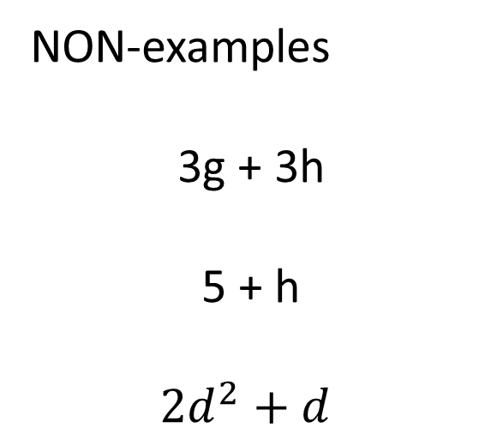
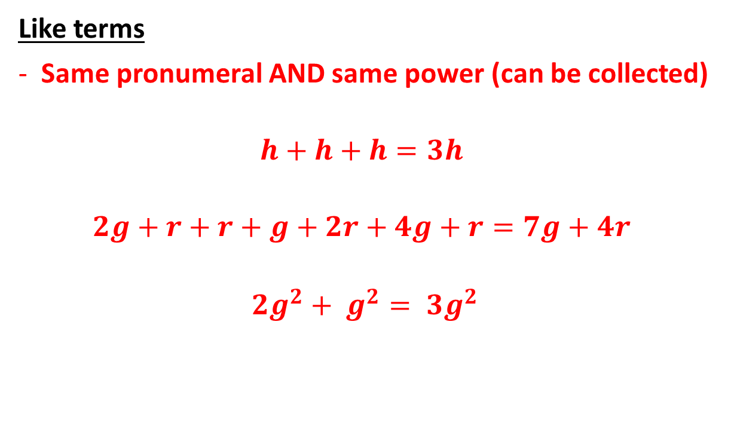
Terminology
Like terms
Same pronumeral AND same power (can be collected)
$$h+h+h=3h$$
$$2g+r+r+g+2r+4g+r=7g+4r$$
$${2g}^{2}+ g^{2}= {3g}^{2}$$
NON-examples
3g + 3h
5 + h
$${2d}^{2}+d$$

Slide 4
We do
a) k + k + k =
b) 2d + 3d + 2d =
c) 4m + 2n +2m + 5n =

Slide 5
You do (whiteboards)
e + e + e + e =
4f + 2f + 3f =
7t + 4r + 2t + 11r =
10h + 5g – 2h + 3g =

Slide 6
Practice 1 – simplify in exercise book
10e + 3e
3d + 5d
19x – 5x
10w + 3e + 2w + 5e
2d + 3d – 7d
2z + 3x + 6y + 4z – 2x + 4y
3x – (-2x) + 5y
-4f + (-2f) + 8f
Answers
13e
8d
14x
12w + 8e
-2d
6z + x + 10y
5x + 5y
2f

Slide 7
Sample space
Sample space:
A LIST of ALL possible outcomes.
Flipping a coin
Rolling a normal die
Days of the week

Slide 8
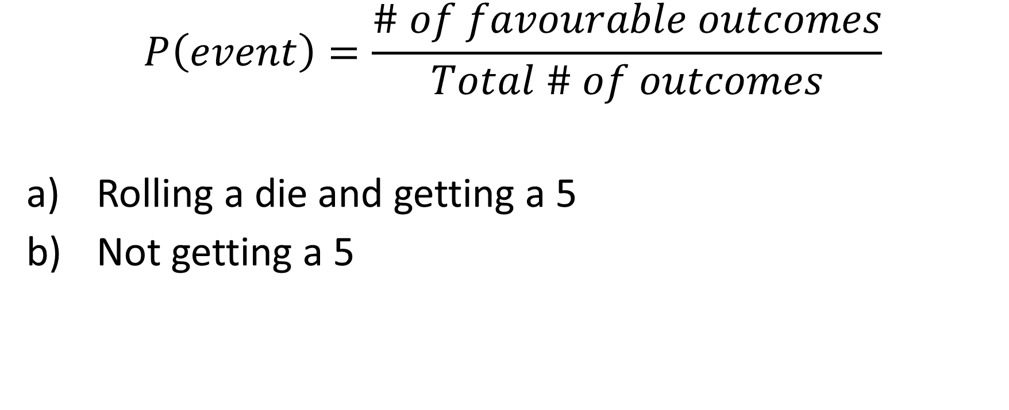
Basic probability
$$P\left(event\right)=\frac{\# of favourable outcomes}{Total \# of outcomes}$$
Rolling a die and getting a 5
Not getting a 5

Slide 9
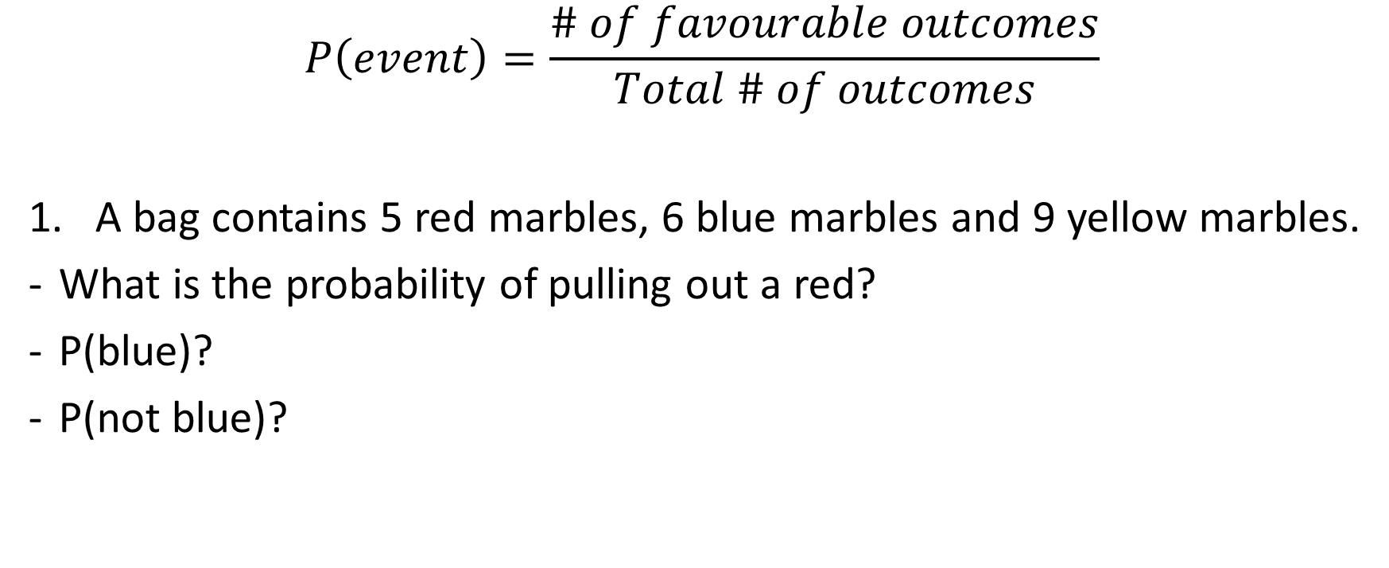
Probability
$$P\left(event\right)=\frac{\# of favourable outcomes}{Total \# of outcomes}$$
A bag contains 5 red marbles, 6 blue marbles and 9 yellow marbles.
What is the probability of pulling out a red?
P(blue)?
P(not blue)?

Slide 10
Complimentary events
Complimentary event
The opposite of something happening
What is the opposite?
Rolling a 4?
Getting a tails?
Person owning a dog?

Slide 11
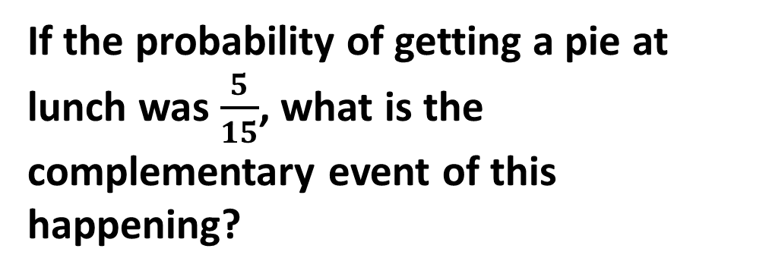
State the (opposite) complimentary event
Rolling a 5
Rolling a 6
Getting a heads
Getting a blue marble
Getting a red marble
Playing soccer
If the probability of getting a pie at lunch was $\frac{5}{15}$, what is the complementary event of this happening?

Slide 12
Assigning probability
In a bag there are 3 red marbles, 3 blue marbles and 4 yellow marbles.
Complimentary events add up to 1
what is the P(red)?
What is the complimentary of this event?

Slide 13
Exercise books
Create some sort of event (rolling dice, coin flip, Dockers winning the flag)
Write down the probability
State the complimentary event
Write down the probability

Slide 14
Individual practice
Complete puzzle sheets formative assessment
“what is Long and Yellow and never rings”

